Slide 1
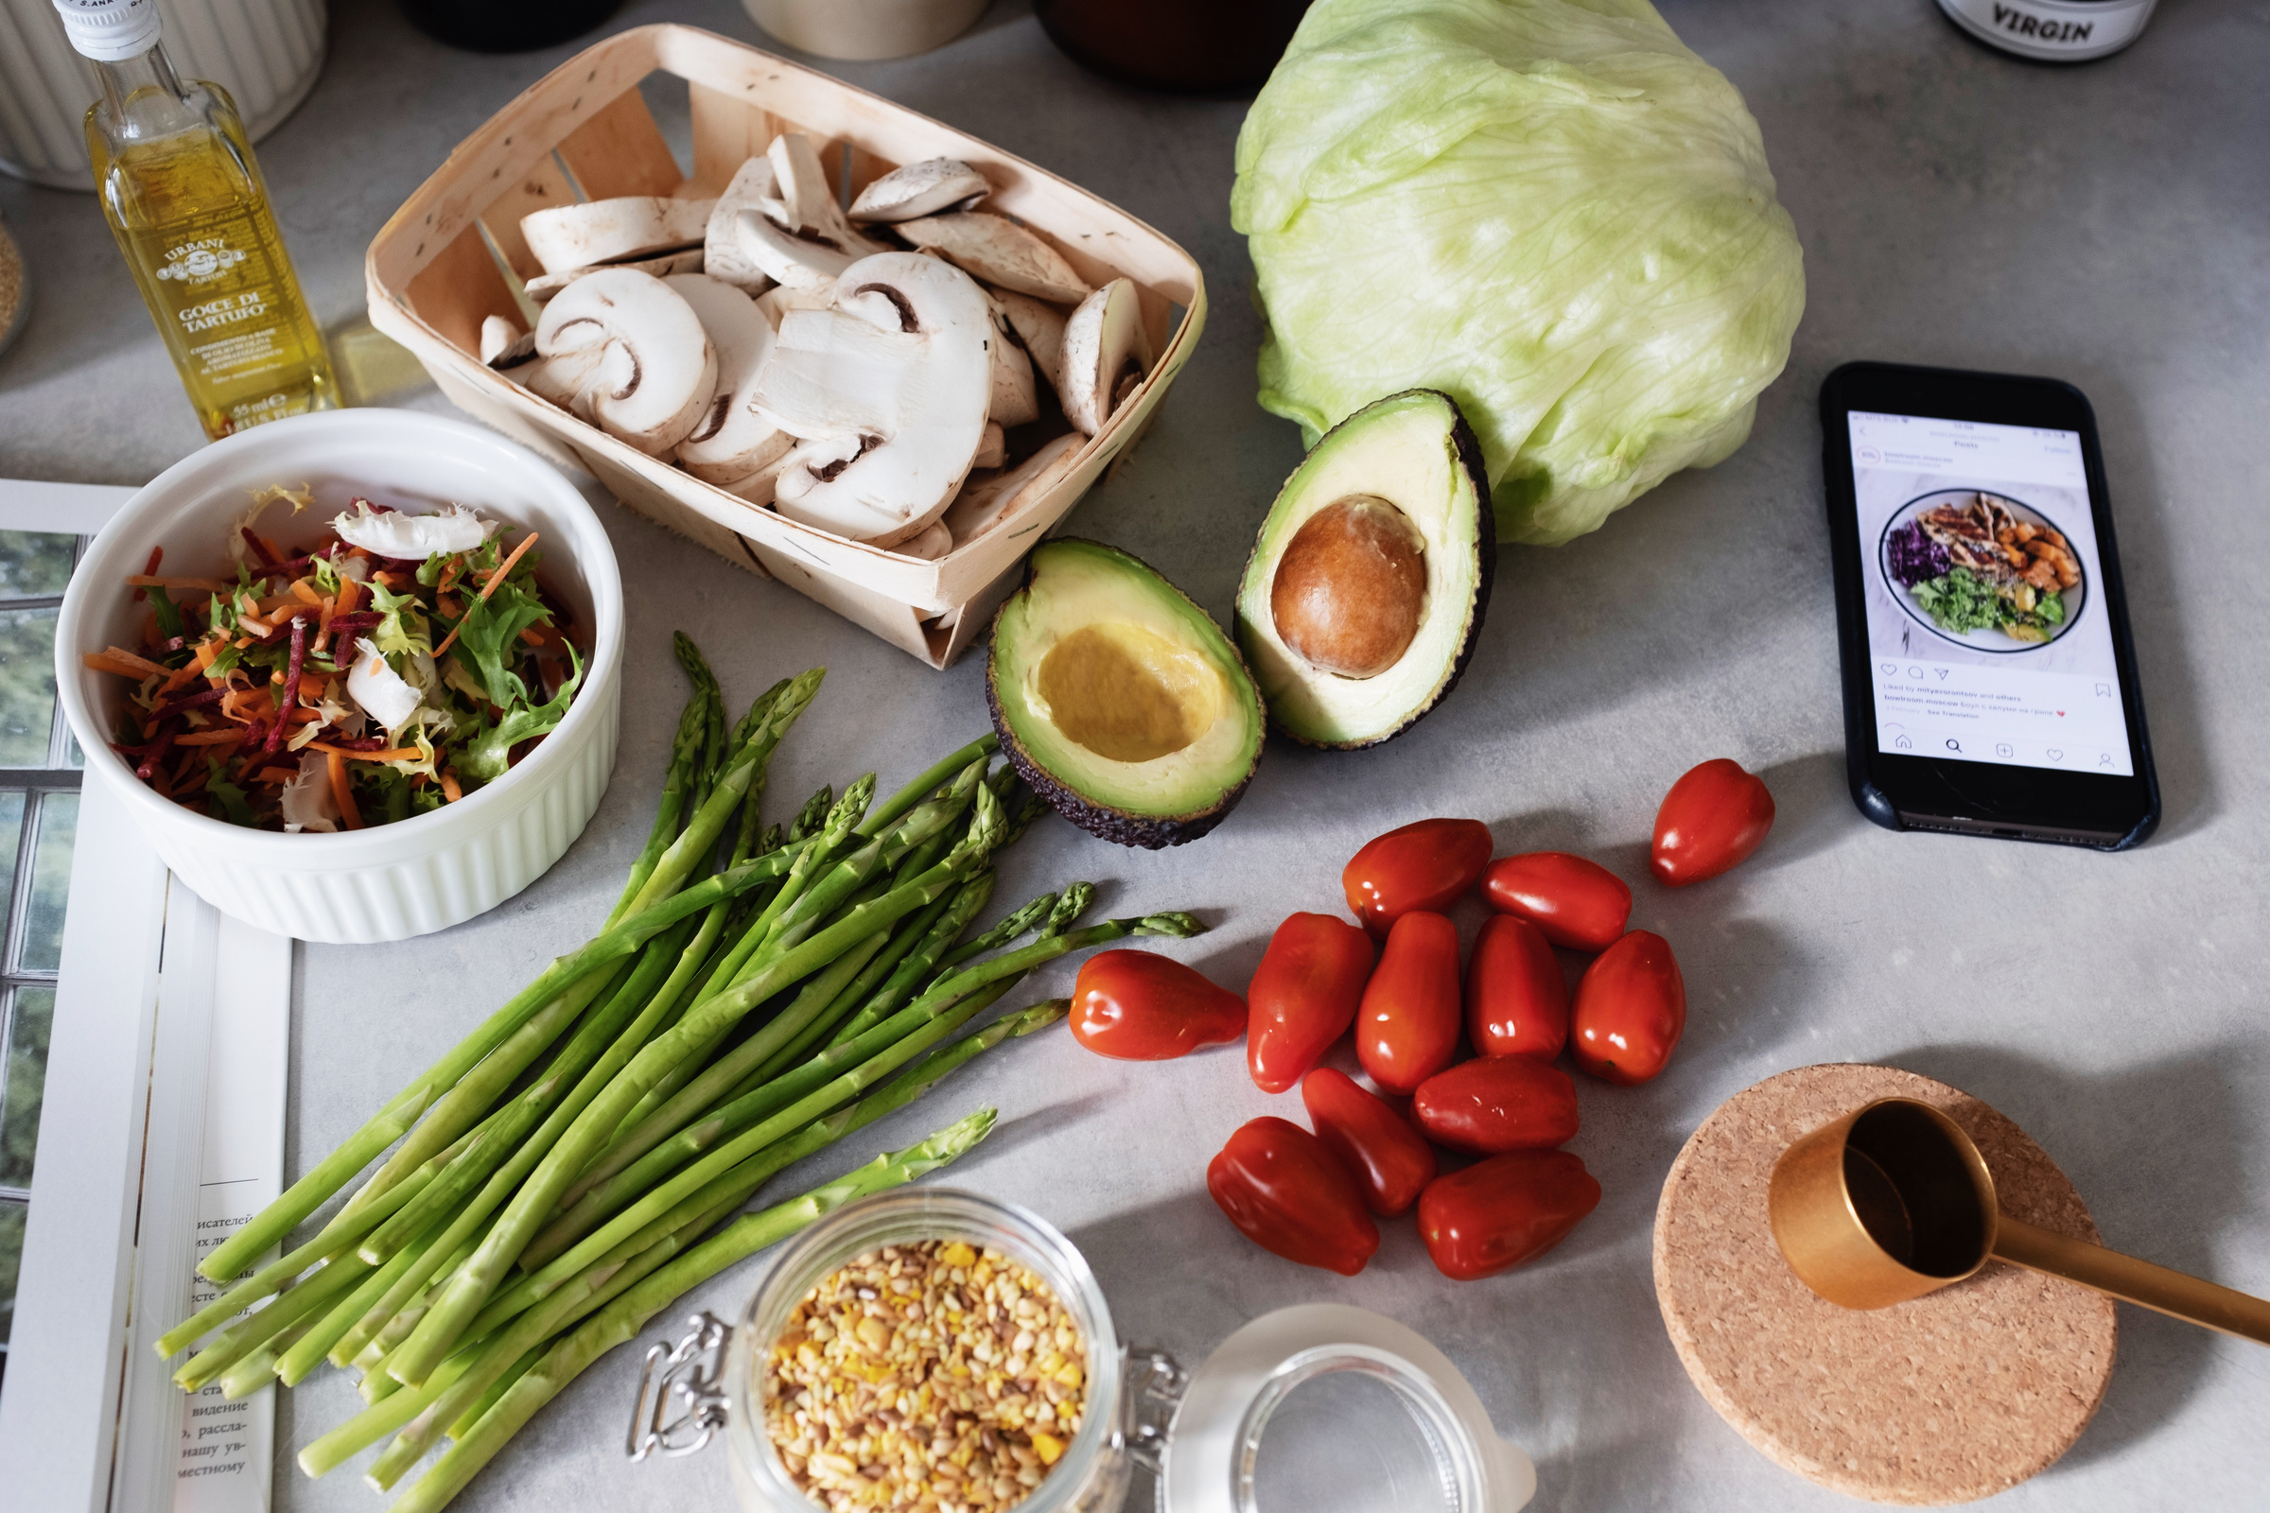
Grocery Bill Management System

Slide 2



Technologies used
IDLE PYTHON (3.10 64-bit)
Db browser – SQLite3
Editor- Visual Studio Code
GUI library – Tkinter

Slide 3
System Overview
This software project is a traditional grocery bill system with some added functionality. This system is built for fast data processing and bill generation for the customers.
The billing system consists of an SQLite3 database and effective front end design.
A product when clicked is added to the cart and its price is added to the bill based upon the product quantity.
After adding all the required products in the cart we generate the bill. With this software we can search for a customers bill easily.
The system calculates the bill along with the GST on each product.
This billing system is built to help supermarkets calculate and display bills and serve the customer in a faster and efficient manner.
This software project consists of an effective and easy GUI to help the employee in easy bill calculation and providing an efficient customer service.

Slide 4
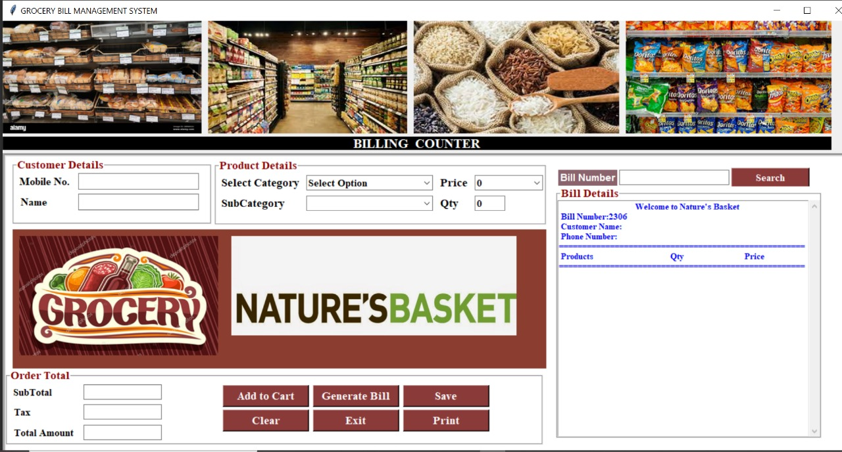
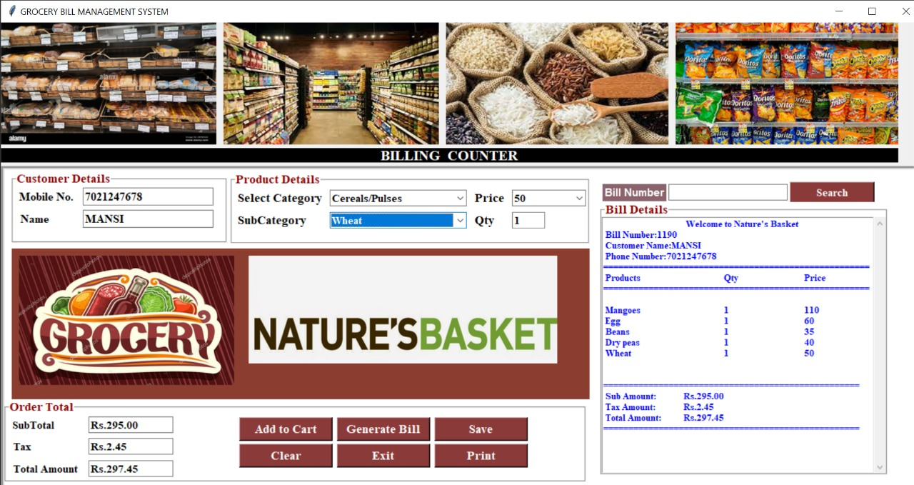
Project working with snapshots

Slide 5
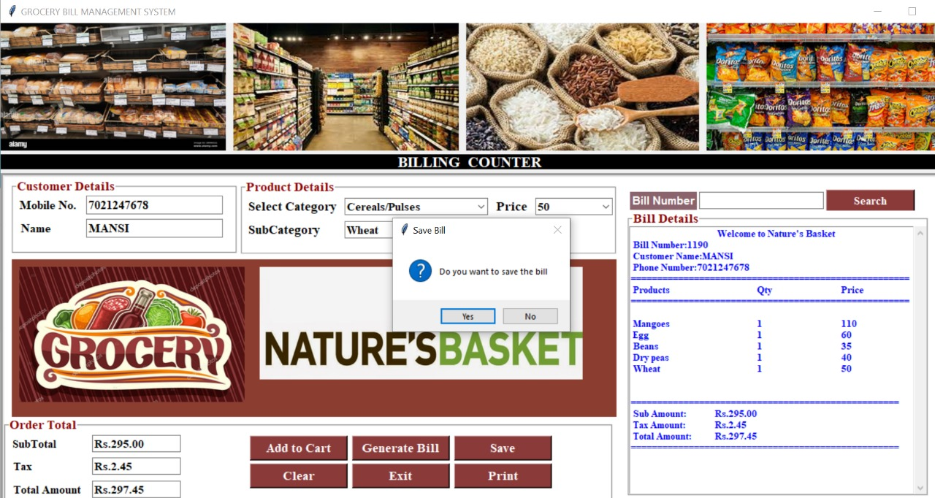
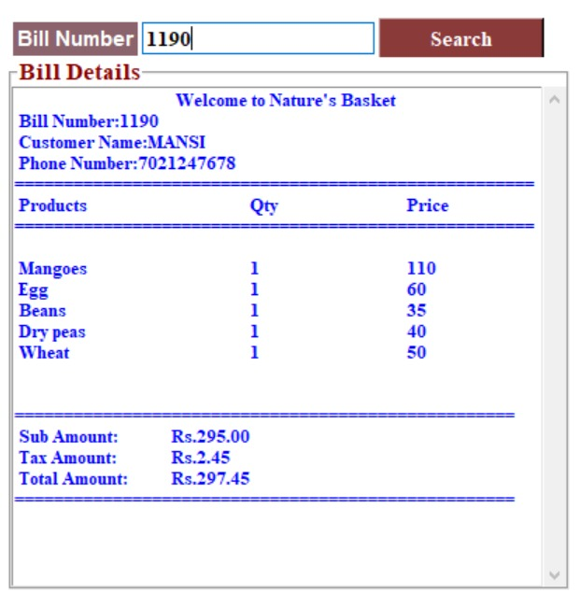
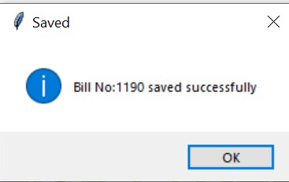
Project working with snapshots
We can search the saved bill with the bill number

Slide 6
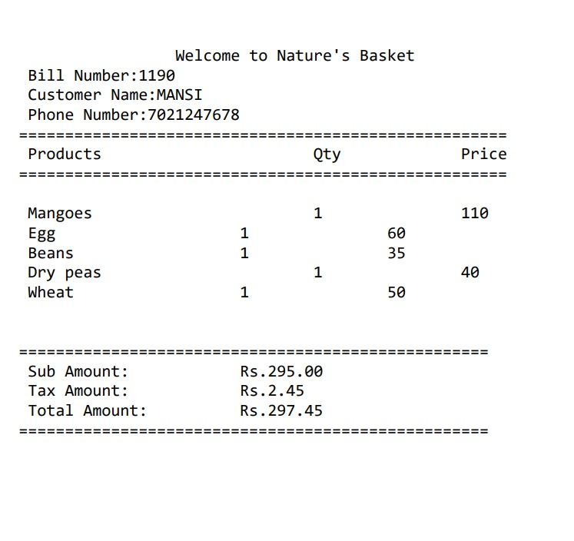
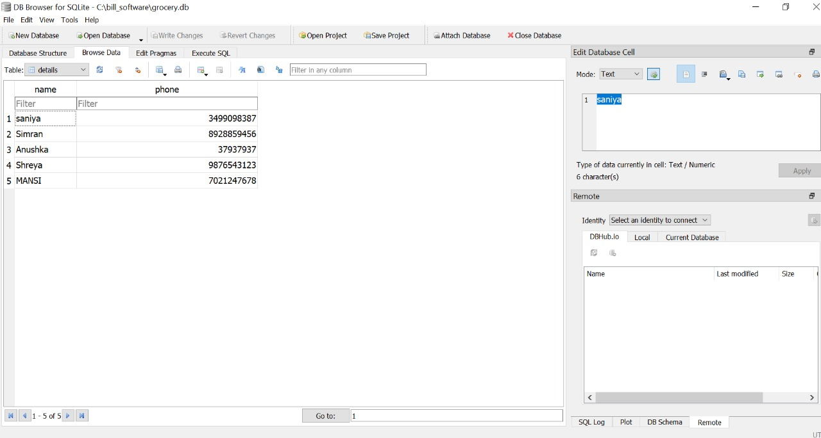
Project working with snapshots
Bill after printing
Customer’s name and mobile no. is stored in the database as shown below

